Slide 1
Module 1 : Introduction to Internet
Internet Communication Engineering

Slide 2
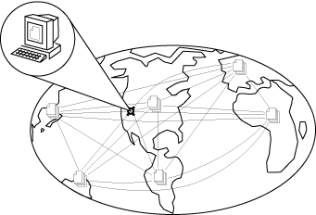
What is Internet
A network of networks, joining many government, university and private computers together.
Provides an infrastructure for the use of E-mail, bulletin boards, file archives etc other computational resources.
The vast collection of computer networks which form and act as a single huge network for transport of data and messages across distances .
The largest network of networks in the world.
Uses TCP/IP protocols and packet switching .
Runs on any communications substrate.

Slide 3
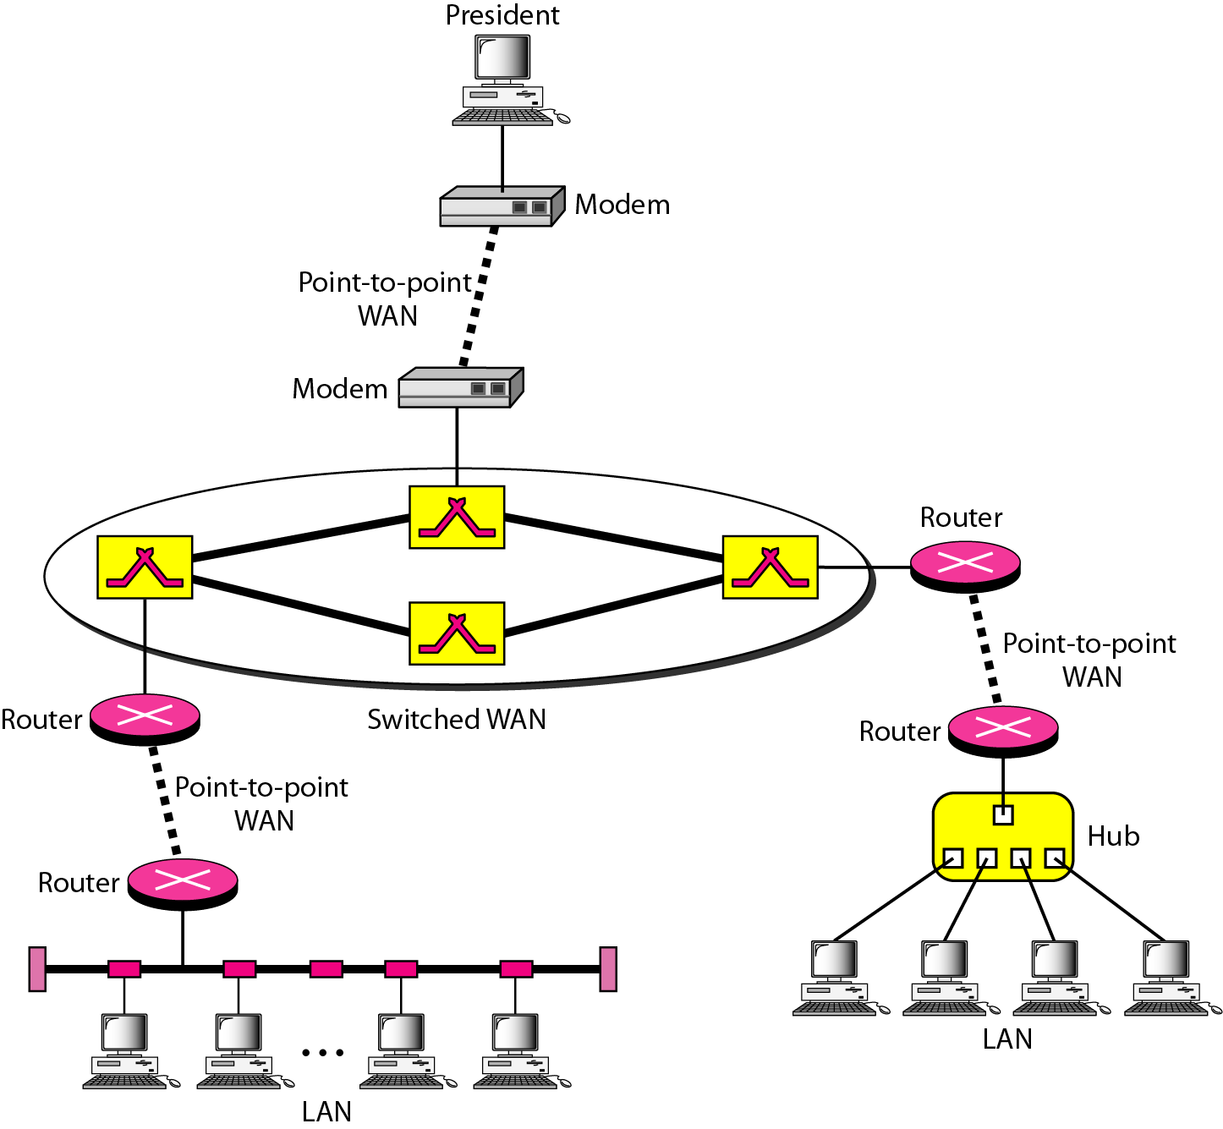
Interconnection of Networks: Internet
A heterogeneous network made of four WANs and two LANs

Slide 4
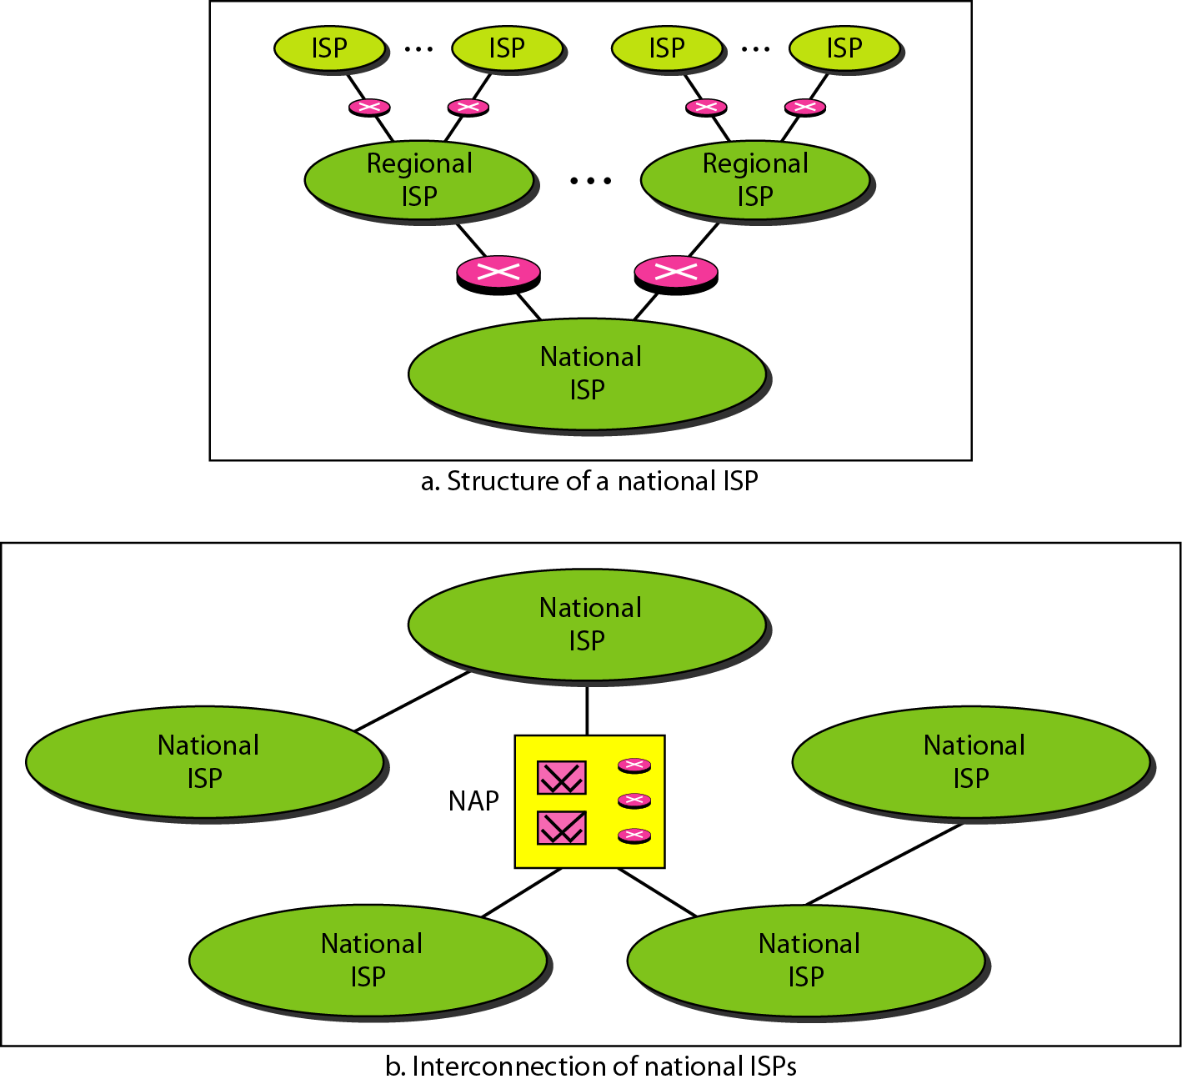
Hierarchical organization of the Internet

Slide 5
Evolution of Internet
1970 ARPANET(Advanced Research Projects Agency) - 15 nodes
1972 first email
1982 TCP/IP becomes internet standard
Transmission Control Protocol/Internet Protocol
1984 ARPANET - 1,000 nodes
1986 NSF(National Science Foundation)-Net backbone on ARPANET
1987 ARPANET - 10,000 nodes

Slide 6
Contd…
1988 - businesses begin to connect to system for research purposes
1989 ARPANET - 100,000 nodes
1989 link email between CompuServe and ARPANET
1990 ARPANET becomes the Internet

Slide 7
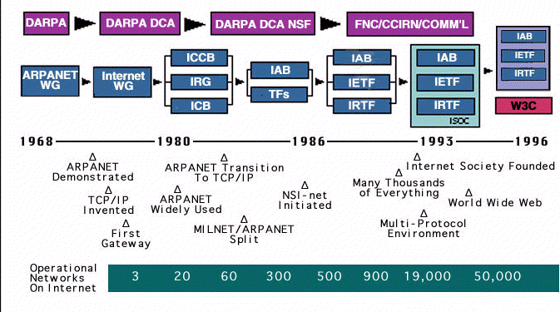
Internet History

Slide 8
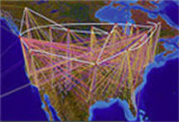
A Brief Summary of the Evolution of the Internet
Age of
eCommerce
Begins
1995
Mosaic
Created
1993
WWW
Created
1989
Internet
Named
and
Goes
TCP/IP
1984
TCP/IP
Created
1972
ARPANET
1969
Hypertext
Invented
1965
Packet
Switching
Invented
1964
First Vast
Computer
Network
Envisioned
1962
Silicon
Chip
1958
A
Mathematical
Theory of
Communication
1948
Memex
Conceived
1945
1945
1995

Slide 9
From Simple, But Significant Ideas Bigger Ones Grow 1940s to 1969
We will prove that packet switching
works over a WAN.
Hypertext can be used to allow
rapid access to text data
Packet switching can be used to
send digitized data though
computer networks
We can accomplish a lot by having a
vast network of computers to use for
accessing information and exchanging ideas
We can do it cheaply by using
Digital circuits etched in silicon.
We do it reliably with “bits”,
sending and receiving data
We can access
information using
electronic computers
1945
1969

Slide 10
From Simple, But Significant Ideas Bigger Ones Grow 1970s to 1995
Great efficiencies can be accomplished if we use
The Internet and the World Wide Web to conduct business.
The World Wide Web is easier to use if we have a browser that
To browser web pages, running in a graphical user interface context.
Computers connected via the Internet can be used
more easily if hypertext links are enabled using HTML
and URLs: it’s called World Wide Web
The ARPANET needs to convert to
a standard protocol and be renamed to
The Internet
We need a protocol for Efficient
and Reliable transmission of
Packets over a WAN: TCP/IP
Ideas from
1940s to 1969
1970
1995

Slide 11
The creation of Internet
The creation of the Internet solved the following challenges:
Basically inventing digital networking as we know it
Survivability of an infrastructure to send / receive high-speed electronic messages
Reliability of computer messaging

Slide 12
Protocols and Standards
protocols and standards.
Protocol is synonymous with rule.
Standards are agreed-upon rules.
Protocols
Syntax → format of the data
Semantics → meaning of each section
Timing → when data should be sent and how fast.
Standards
De facto → by fact (not approved as a standard)
De jure → by Law (approved)

Slide 13
Protocols and Standards
Standards Organizations
International Organization for Standardization (ISO)
International Telecommunication Union - Telecommunication Standards (ITU-T)
American National Standards Institute (ANSI)
Institute of Electrical and Electronics Engineers (IEEE)
Electronic Industries Association (EIA)

Slide 14
There are 2 standard Network Models : - OSI Model - TCP/IP Protocol Suite
Network Models

Slide 15
Layered Tasks
A network model is a layered architecture
Task broken into subtasks
Implemented separately in layers in stack
Functions need in both systems
Peer layers communicate
Protocol:
A set of rules that governs data communication
It represents an agreement between the communicating devices

Slide 16
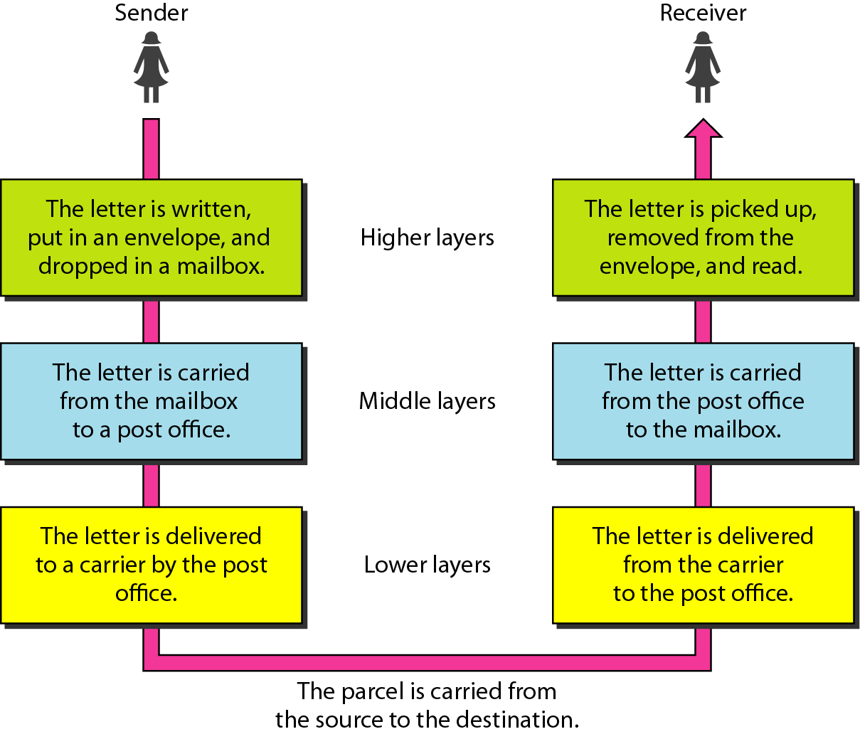
Tasks involved in sending a letter

Slide 17
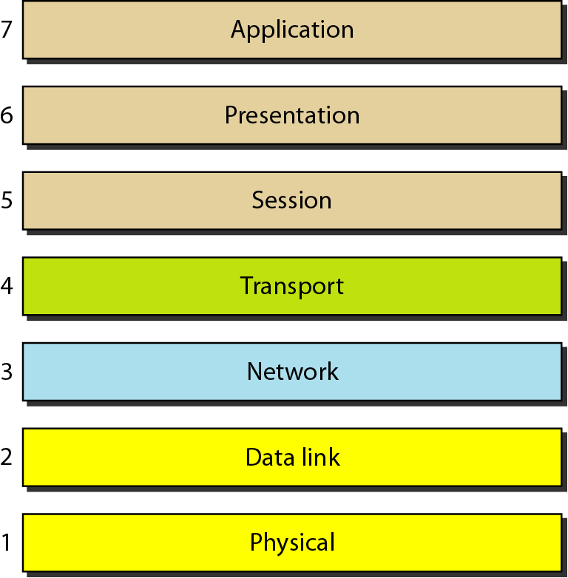
OSI Layered Architecture
Layers
Layer 7. Application
Layer 6. Presentation
Layer 5. Session
Layer 4. Transport
Layer 3. Network
Layer 2. Data Link
Layer 1. Physical
Seven layers of the OSI model
Sender
Receiver

Slide 18
Layered Architecture
A layered model
Each layer performs a subset of the required communication functions
Each layer relies on the next lower layer to perform more primitive functions
Each layer provides services to the next higher layer
Changes in one layer should not require changes in other layers
The processes on each machine at a given layer are called peer-to-peer process

Slide 19
Peer to peer process
Communication must move downward through the layers on the sending device, over the communication channel, and upward to the receiving device
Each layer in the sending device adds its own information to the message it receives from the layer just above it and passes the whole package to the layer just below it
At the receiving device, the message is unwrapped layer by layer, with each process receiving and removing the data meant for it

Slide 20
Contd…
The passing of the data and network information down through the layers of the sending device and backup through the layers of the receiving device is made possible by interface between each pair of adjacent layers
Interface defines what information and services a layer must provide for the layer above it.

Slide 21
Physical Layer
The physical layer is responsible for movements of
individual bits from one hop (node) to the next.
Function
Physical characteristics of interfaces and media
Representation of bits
Data rate
Synchronization of bits
Line configuration (point-to-point or multipoint)
Physical topology (mesh, star, ring or bus)
Transmission mode ( simplex, half-duplex or duplex)

Slide 22
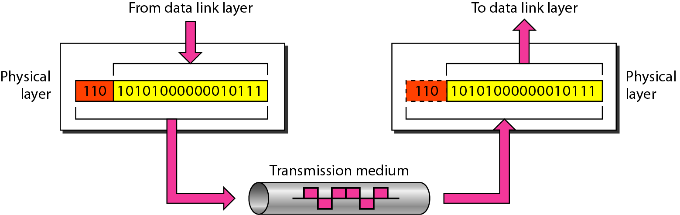
Physical layer

Slide 23
Network Layer
The network layer is responsible for the delivery of individual packets from
the source host to the destination host.
Source-to-destination delivery
Responsible from the delivery of packets from the original source to the final destination
Functions
Logical addressing
routing

Slide 24
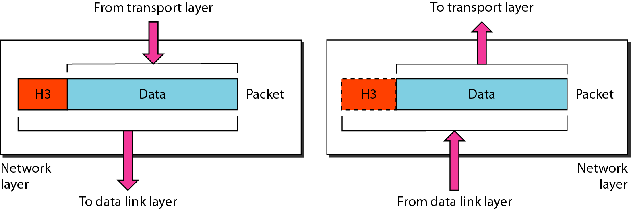
Network Layer

Slide 25
Transport Layer
The transport layer is responsible for the delivery of a message from one process to another.
Process-to- process delivery
Functions
Port addressing
Segmentation and reassembly
Connection control ( Connection-oriented or connection-less)
Flow control
Error control

Slide 26
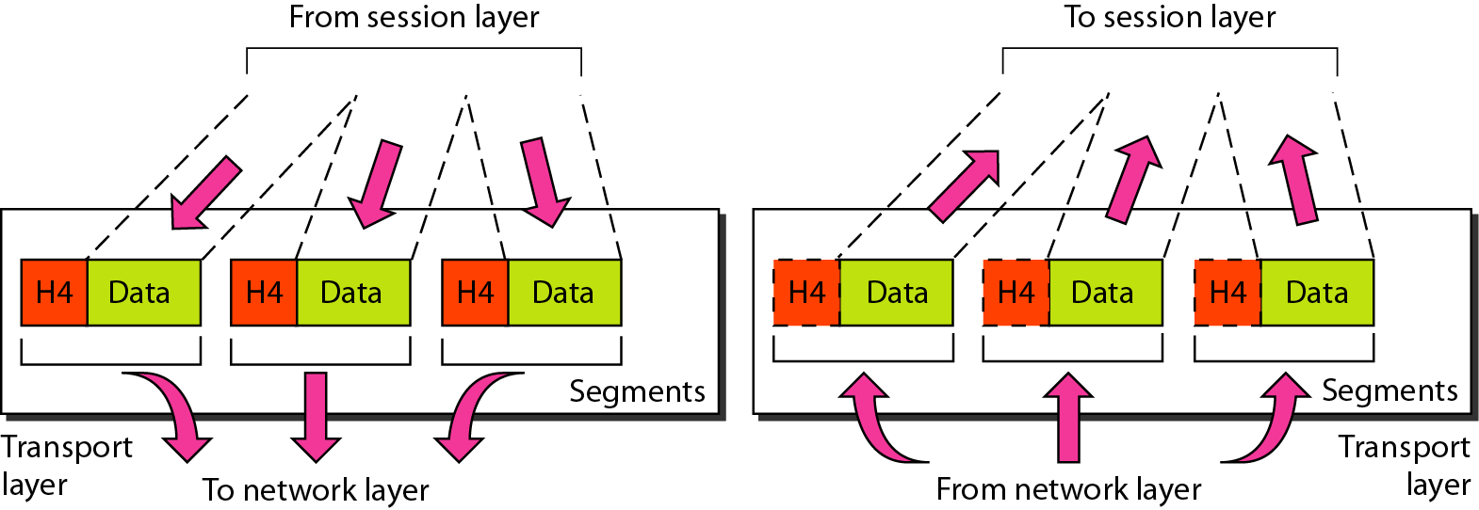
Transport Layer
Segmentation and reassembly

Slide 27
Session Layer
The session layer is responsible for dialog control and synchronization.
It establishes, maintains and synchronize the interaction between communicating system
Function
Dialog control
Synchronization (checkpoints)

Slide 28
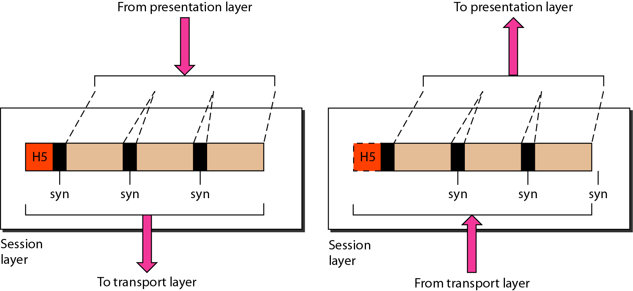
Session layer
Synchronization

Slide 29
Presentation Layer
The presentation layer is responsible for translation, compression, and encryption.
Concerned with the syntax and semantics of the information exchanged between two system
Functions
Translation ( EBCDIC-coded text file → ASCII-coded file)
Encryption and Decryption
Compression

Slide 30
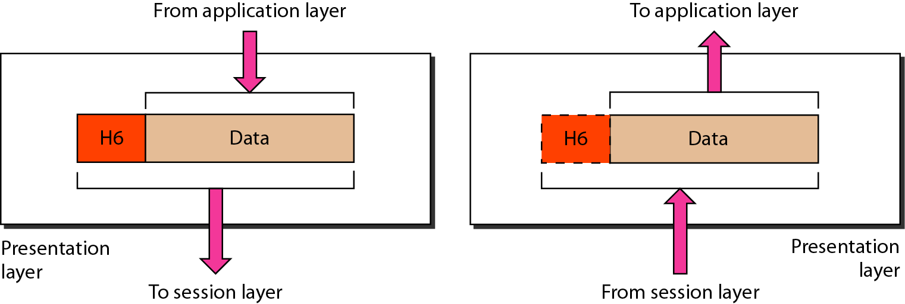
Presentation layer

Slide 31
Application Layer
The application layer is responsible for providing services to the user.
Functions
Network virtual terminal (Remote log-in)
File transfer and access
Mail services
Directory services (Distributed Database)
Accessing the World Wide Web

Slide 32
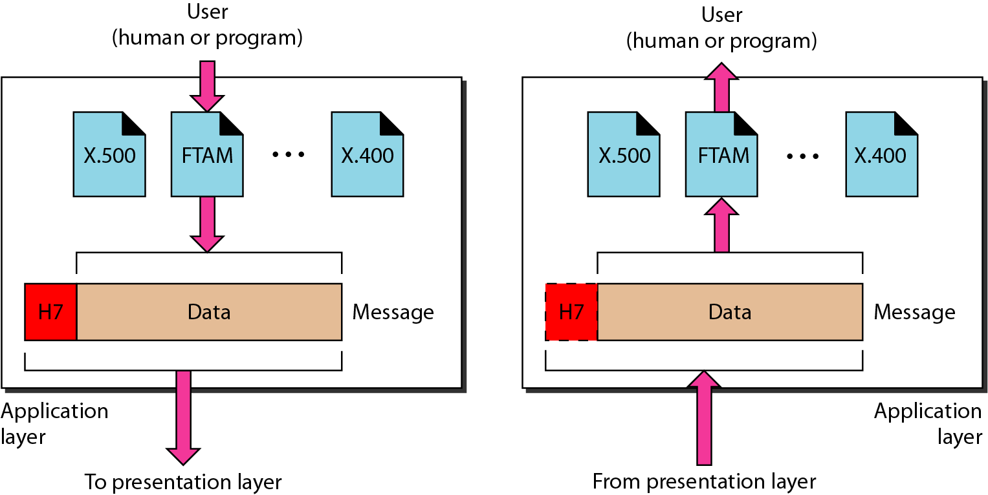
Application Layer

Slide 33
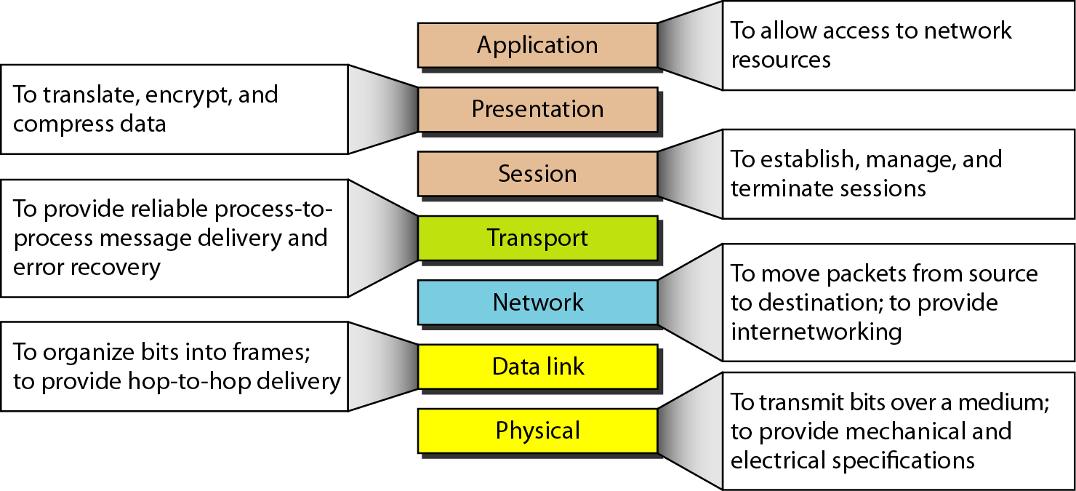
Summary of Layers

Slide 34
TCP/IP Protocol Suite
The layers in the TCP/IP protocol suite do not exactly match those in the OSI model. The original TCP/IP protocol suite was defined as having four layers: host-to-network, internet, transport, and application. However, when TCP/IP is compared to OSI, we can say that the TCP/IP protocol suite is made of five layers: physical, data link, network, transport, and application.

Slide 35
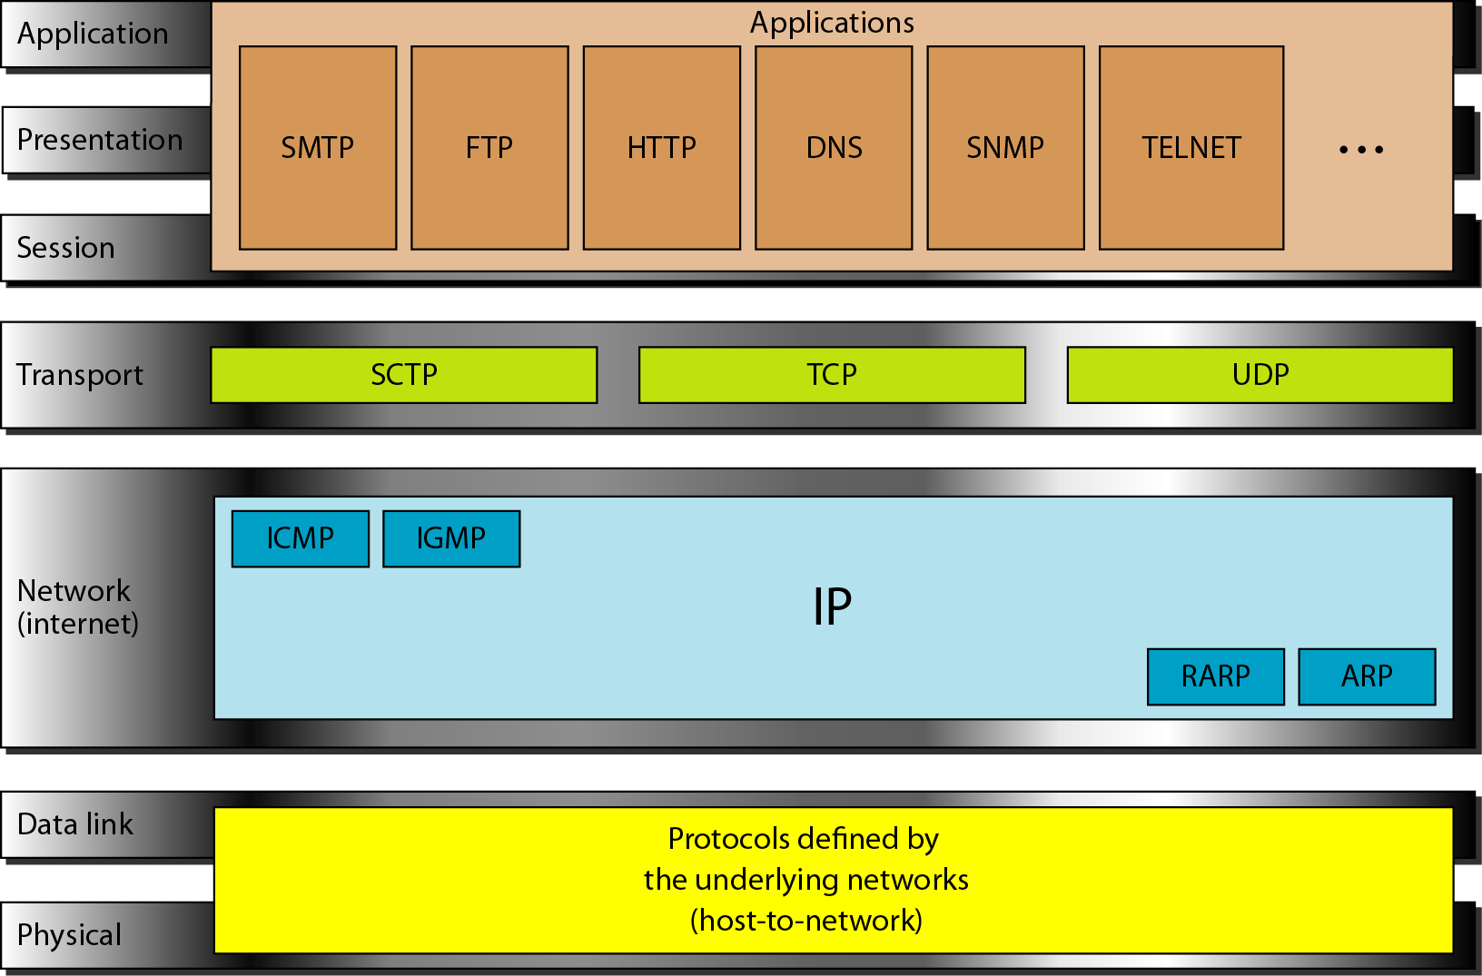
TCP/IP and OSI model

Slide 36
Internet Layer
TCP/IP support the Internet Protocol IP ( unreliable).
IP is a host-to-host protocol.
Supporting protocols:
Address Resolution Protocol (ARP)
Reverse Address Resolution Protocol (RARP)
Internet Control Massage Protocol (ICMP)
Internet Group Massage Protocol (IGMP)

Slide 37
Transport Layer
Process-to-process protocol.
User Datagram Protocol (UDP)
Transmission Control Protocol (TCP)
Stream Control Transmission Protocol (SCTP)

Slide 38
ADDRESSING
Four levels of addresses are used in an internet employing the TCP/IP protocols: physical, logical, port, and specific.

Slide 39
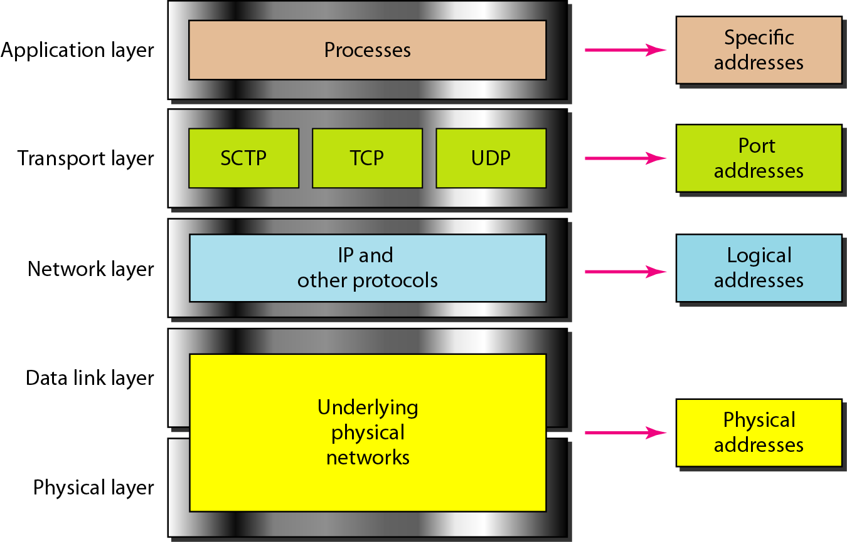
Relationship of layers and addresses in TCP/IP

Slide 40
Physical Address
Physical addresses are imprinted on the NIC. Most local-area networks (Ethernet) use a 48-bit (6-byte) physical address written as 12 hexadecimal digits; every byte (2 hexadecimal digits) is separated by a colon.
Example:
07:01:02:01:2C:4B A 6-byte (12 hexadecimal digits) physical address.

Slide 41
Physical Address
known also as the MAC address
Is the address of a node as defined by its LAN or WAN
It is included in the frame used by data link layer
The physical addresses in the datagram may change from hop to hop.

Slide 42
Port addresses
Port address is a 16-bit address represented by one decimal number ranged from (0-65535) to choose a process among multiple processes on the destination host.
Destination port number is needed for delivery.
Source port number is needed for receiving a reply as an acknowledgments.
In TCP/IP , a 16-bit port address represented as one single number. Example: 753
The physical addresses change from hop to hop,
but the logical and port addresses usually remain the same.

Slide 43
Logical Address
IP addresses are necessary for universal communications that are independent of physical network.
No two host address on the internet can have the same IP address
IP addresses in the Internet are 32-bit address that uniquely define a host.
The physical addresses will change from hop to hop,
but the logical addresses usually remain the same.

Slide 44
Specific addresses
E-mail address (user1@ksu.edu.sa)
Universal Resource Locator (URL) (www.ksu.edu.sa)
The Domain Name System (DNS) translates human-friendly computer hostnames ( URL) into IP addresses. For example, www.example.com is translated to 208.77.188.166

Slide 45
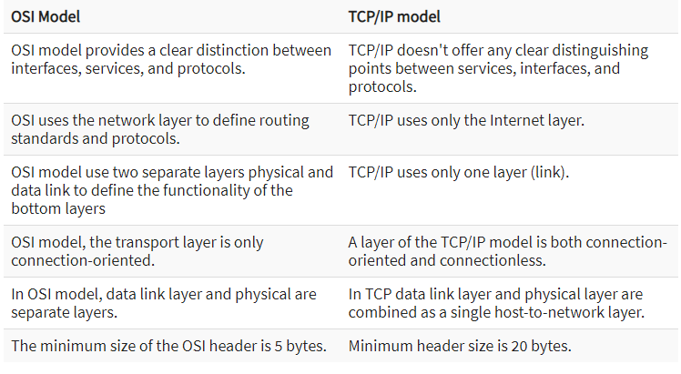

Slide 46
Advantages of TCP/IP
It helps you to establish/set up a connection between different types of computers.
It operates independently of the operating system.
It supports many routing-protocols.
It enables the internetworking between the organizations.
TCP/IP model has a highly scalable client-server architecture.

Slide 47
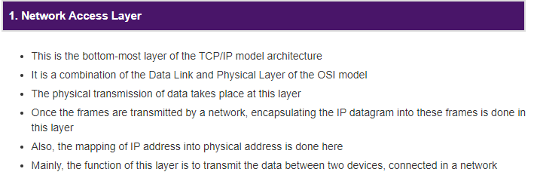

Functions

Slide 48
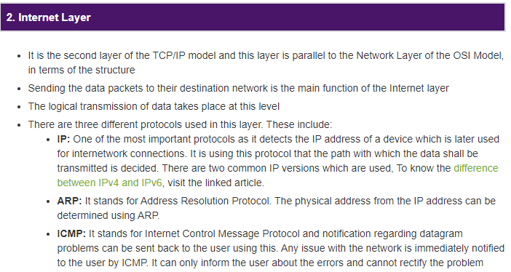
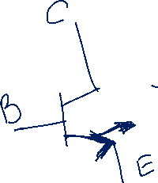

Contd…

Slide 49
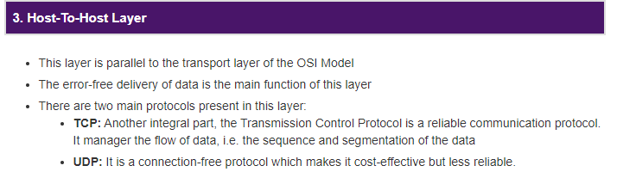
Contd…

Slide 50
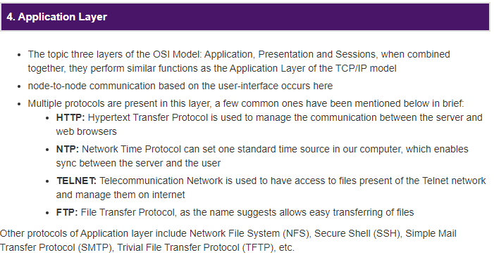
Contd…

